Slide 2
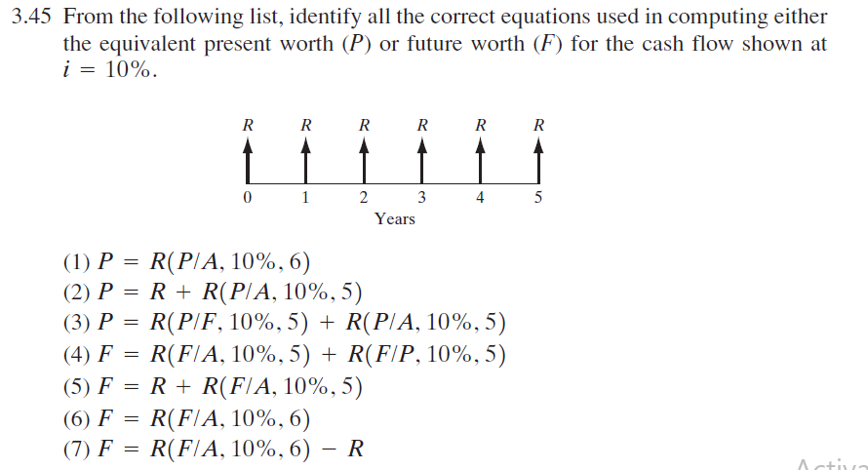
1. (4 minutes)

Slide 3
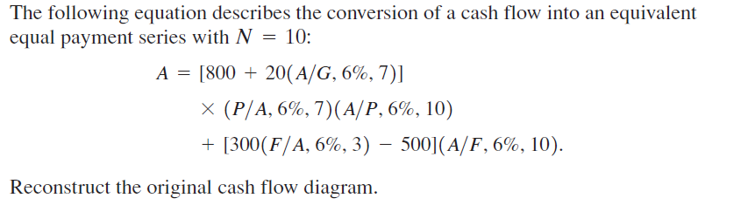
2. (5 minutes)

Slide 4
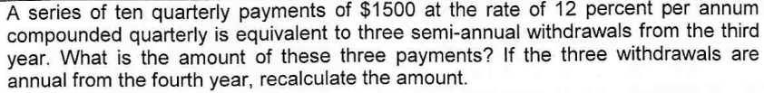
3. (8 minutes)
6075
7662

Slide 5
4. 8 minutes
Apex Corporation requires a chemical finishing process for a product under contract for a period of six years. Three options are available. Neither Option 1 nor Option 2 can be repeated after its process life. However, Option 3 will always be available from H&H Chemical Corporation at the same cost during the period that the contract is operative. Here are the options: · Option 1. Process device A, which costs $100,000, has annual operating and labor costs of $60,000 and a useful service life of four years with an estimated salvage value of $10,000. · Option 2. Process device B, which costs $150,000, has annual operating and labor costs of $50,000 and a useful service life of six years with an estimated salvage value of $30,000. · Option 3. Subcontract out the process at a cost of $100,000 per year. According to the Present-worth criterion, which option would you recommend at i=12%?

Slide 6
5. 8 minutes
Emily Wang financed her office furniture from a bank. The bank’s terms allowed her to defer (postpone) payments for six months (first instalment at end of the 6th month) and to make 36 equal end-of-month payments thereafter. The loan was for $15,000, with interest at 10% compounded monthly. After 26 equal monthly payments (undisclosed), Emily found herself in a financial difficulty and went to the bank for assistance with the loan. The bank offered that she could pay $186 per month for the next 30 months. Determine the original monthly payment made to bank.

Slide 7
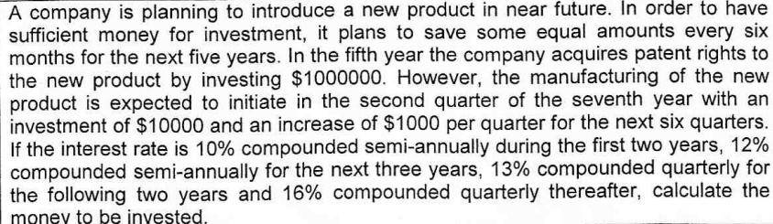
For practice.. (12 minutes) + 3 minutes
82988

